Slide 1
Chapter 7 Synchronization Examples

Slide 2
Outline
Classic Problems of Synchronization
Bounded-Buffer Problem
Readers and Writers Problem
Dining-Philosophers Problem
POSIX Synchronization

Slide 3
有Race Condition的版本

Slide 4
Example: Producer-Consumer Problem
Producer produces data item in a buffer that is consumed by a consumer
The buffer, in, and out stored in the shared memory
#define BUFFER_SIZE 10
typedef struct {
. . .
} item;
item buffer[BUFFER_SIZE]; //in shared memory
int in = 0; //in shared memory
int out = 0; //in shared memory
out
in

Slide 5
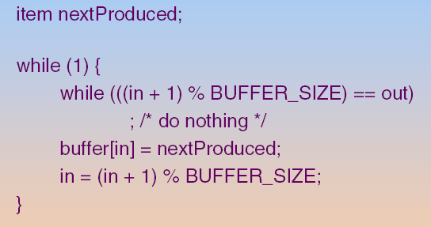
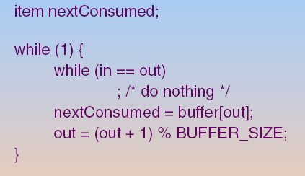
Bounded-Buffer : Shared-Memory Solution
Producer
Consumer
Problem?
Both processes attempt to access the in, out and buffer concurrently

Slide 6
如第六章所述, 上述程式會產生race condition. Q: 假設使用semaphore, 如何debug?
Hint: 我們需要哪些semaphore?

Slide 7
Q: 我們需要哪些semaphore?
Hint: 思考那些情形程式會被blocked?

Slide 8
Q: 為什麼需要思考會被blocked的情形呢?
Ans:會被blocked的地方就需要semaphore

Slide 9
Bounded-Buffer Problem
那些情形程式會被blocked?
1. buffer為空⇨consumer必須被blocked
2. buffer為滿⇨producer必須被blocked
3. producer(consumer)想存取buffer, 但buffer被consumer (producer)存取中⇨producer(consumer)必須被blocked
所以, 我們需要三個semaphores

Slide 10
Bounded-Buffer Problem
Assume buffer size = N
Three semaphores
Semaphore mutex initialized to the value 1
Synchronize to access buffer
Semaphore full initialized to the value 0
Semaphore empty initialized to the value N.

Slide 11
Q: Producer的程式碼?

Slide 12
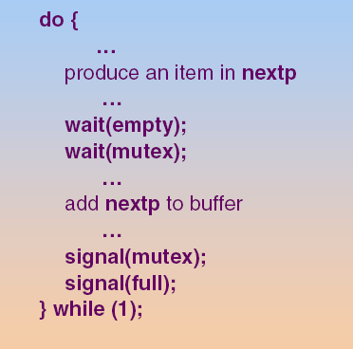
Producer

Slide 13
Q: Consumer的程式碼?

Slide 14
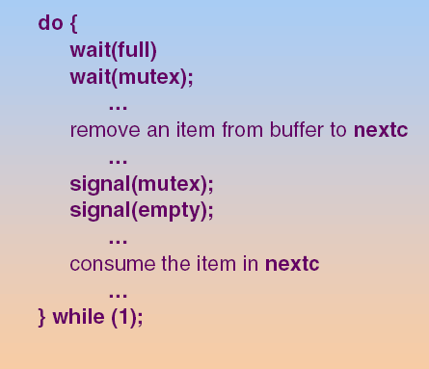
Consumer

Slide 15
Q: Semaphore Full的用途?
Hint: 看個例子

Slide 16
Consumer Cannot Consume Data When Full is Empty (=0)
Initially, full=0, mutex=1,empty = N (=10)
Producer | Consumer
 | wait(full):full=-1 Add to Full.L
wait(empty):empty=N-1
wait(mutex):mutex=0
Add item to the buffer
signal(mutex):mutex=1
signal(full):full=0 wait up Consumer
 | wait(mutex):mutex=0
 | ---
Semaphore full 用來確保當buffer為空時(full = 0)，Consumer無法consume資料

Slide 17
Q: Semaphore Empty的用途?
Hint: 看個例子

Slide 18
Producer Cannot Produce Data When Empty is Full (=N)
假設某個時間點：full=5, mutex=1,empty = 10-5=5, 然後
Producer | Consumer
Add item to the buffer
……
Producer一直produce item to the buffer
假設此時buffer滿了 full=N, mutex=1,empty = 0
wait(empty):empty=-1 Add to empty.L
 | wait(full):full=N-1
 | …//remove an item
 | signal(empty):empty=0 Wait up Producer
假設Producer一直執行
Semaphore empty 用來確保當buffer為滿時(empty = 0)，Producer無法produce資料

Slide 19
Q: Semaphore mutex的用途?
Hint: 看個例子

Slide 20
Producer and Consumer Cannot Access Buffer Simultaneously by Semaphore mutex
假設某個時間點：full=4, mutex=1,empty = 6, 然後
Producer | Consumer
wait(empty); //empty=5
wait(mutex); //mutex = 0
Producer access buffer //produce item to the buffer
…… | wait(full); //full = 3
 | wait(mutex):mutex=-1 Add to empty.L
Producer access buffer //produce item to the buffer
signal(mutex); //mutex = 0 Wait up Consumer
Semaphore mutex 用來保護Buffer，確保Producer和Consumer不會同時存取buffer

Slide 21
Outline
Classic Problems of Synchronization
Bounded-Buffer Problem
Readers and Writers Problem
Dining-Philosophers Problem
POSIX Synchronization

Slide 22
Readers-Writers Problem
Question: a data set is shared among a number of processes
Readers – only read the data set; they do not perform any updates
Writers – can both read and write.
Goal
Either multiple readers to read at the same time.
Or only one single writer can access the data

Slide 23
Readers-Writers Problem
Reader
Writer
Reader
Writer
Reader
Writer
Reader
Writer
Reader
Writer
Reader
Writer
Reader
Reader
Writer
Shared Resource
from “Operating Systems by NUTT”

Slide 24
Q: 程式怎麼寫呢?
Hint: 需要那些共享變數和semaphores呢?

Slide 25
Readers-Writers Problem
需要的共享變數
Data set
Integer read_count
Initialized to 0.
Keep track of how many readers are currently reading the data set

Slide 26
Q: 為什麼需要read_count變數?
Ans: 有一個reader以上時, reader可以進入但writer不可進入
沒有reader時, writer才有機會進入

Slide 27
Readers-Writers Problem
Q: 需要那些semaphore?
Hint: 需要被保護的情形?
1. 存取read_count:
因為read_count是共享變數, 每一個reader都會存取
2. 存取data set
Data set也是共享的, reader/writer都會想存取

Slide 28
Readers-Writers Problem
所以, 我們需要兩個semaphores
Binary semaphore mutex:
Initialized to 1.
Synchronize access to read_count
Binary semaphore rw_mutex
Initialized to 1.
Synchronize access to the shared data set

Slide 29
Q: Writer的程式?

Slide 30
The Structure of a Writer Process
while (true) { wait(rw_mutex);
... /* writing is performed */
...
signal(rw_mutex);
}

Slide 31
Q: Reader的程式?

Slide 32
The Structure of a Reader Process
while (true){ wait(mutex); read_count++; if (read_count == 1) //first reader
wait(rw_mutex);
signal(mutex);
... /* reading is performed */
...
wait(mutex); read count--; if (read_count == 0) //last reader
signal(rw_mutex);
signal(mutex);
}

Slide 33
Readers-Writers Problem
Reader
Writer
Reader
Writer
Reader
Writer
Reader
Writer
Reader
Writer
Reader
Writer
Reader
Reader
Writer
Shared Resource
from “Operating Systems by NUTT”

Slide 34
Q: Semaphore rw_mutex的用途?
Hint: 看個例子

Slide 35
rw_mutex的用途： 保護Data Set
Initially, read_count=0,rw_mutex=1,mutex = 1
Writer 1 | Reader 1 | Reader 2
wait(rw_mutex);//rw_mutex=0 | --- | ---
Writing | --- | ---
 | wait(mutex); //mutex=0 | ---
 | read_count++; //read_count=1 | ---
 | wait(rw_mutex); //rw_mutex=-1 Add to rw_mutex.L | ---
 |  | wait(mutex);//mutex=-1 Add to mutex.L
Writing
Semaphore rw_mutex 用來確保只有一個writer或是多個readers可以存取Data Set

Slide 36
Readers-Writers Problem (Cont.)
如上頁例子，if a writer is in the CS and n readers are waiting, then
One reader is blocked on rw_mutex
The other n-1 readers are blocked on mutex

Slide 37
Readers-Writers Problem
Reader
Writer
Reader
Writer
Reader
Writer
Reader
Writer
Reader
Writer
Reader
Writer
Reader
Reader
Writer
Shared Resource
from “Operating Systems by NUTT”

Slide 38
Q: Semaphore rw_mutex的用途?
Hint: 再看個例子

Slide 39
rw_mutex的用途： 保護Data Set (Cont.)
Initially, read_count=0,rw_mutex=1,mutex = 1
Writer 1 | Reader 1 | Reader 2
 | wait(mutex);//mutex=0 | ---
 | read_count++; //read_count=1 | ---
 | //first reader wait(rw_mutex);//rw_mutex=0 | ---
 | signal(mutex);//mutex=1 | ---
 | Reading | ---
wait(rw_mutex);//rw_mutex=-1 Add to rw_mutex.L |  | ---
 | Reading | ---
 |  | wait(mutex):mutex=0
 |  | read_count++; //read_count=2
 |  | signal(mutex);//mutex=1
 |  | Reading
Semaphore rw_mutex 用來確保只有一個writer或是多個readers可以存取Data Set

Slide 40
Q: Semaphore mutex的用途?
Hint: 看個例子

Slide 41
mutex的用途：保護read_count
Initially, read_count=0,rw_mutex=1,mutex = 1
Writer 1 | Reader 1 | Reader 2
 | wait(mutex);//mutex=0 | ---
 | read_count++; //read_count=1 | ---
 |  | wait(mutex):mutex=-1 Add to mutex.L
 | //first reader wait(rw_mutex);//rw_mutex=0
 | signal(mutex);//mutex=0 Wait up Reader 2
 | Reading | ---
 |  | read_count++; //read_count=2
 |  | signal(mutex);//mutex=1
 |  | Reading
Semaphore mutex 用來確保同時只有一個reader可以存取read_count

Slide 42
Readers-Writers Problem (Cont.)
On signal (rw_mutex) by a writter
we can wakeup a set of waiting readers or a single waiting writer
See the following slide
Depends on the scheduler

Slide 43
Readers-Writers Problem
Reader
Writer
Reader
Writer
Reader
Writer
Reader
Writer
Reader
Writer
Reader
Writer
Reader
Reader
Writer
Shared Resource
from “Operating Systems by NUTT”

Slide 44
Outline
Classic Problems of Synchronization
Bounded-Buffer Problem
Readers and Writers Problem
Dining-Philosophers Problem
POSIX Synchronization

Slide 45
Dining-Philosophers Problem
Q: five philosophers, who only eat and think
To eat, two chopsticks are required
But taking one chopstick at a time
But wee have only 5 forks

Slide 46
Q:這個例子如何對應到實際的程式呢?
Hint 1: 哲學家代表?
Hint 2: 刀叉代表?

Slide 47
Q: 假設使用semaphore, 需要幾個semaphores?
Ans: 因為有5個共享變數(每一個刀叉就是一個共享變數),所以需要5個semaphores

Slide 48
Q: 程式怎麼寫呢?
Hint: 吃飯需要兩個刀叉
Ans: 所以每一個哲學家吃飯時需要取得兩個semaphores

Slide 49
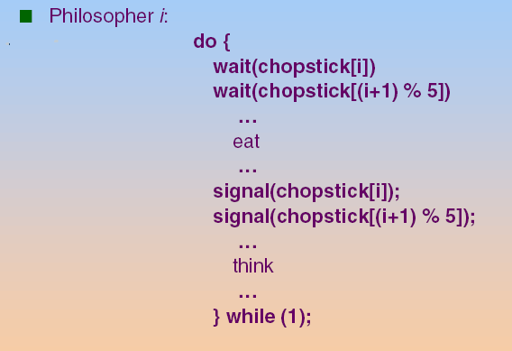
Solution 1: Using Semaphore for the Dining-Philosophers Problem
Shared data: semaphore chopstick[5]; //Initially, all values are 1

Slide 50
Q: However, the previous solution may cause a deadlock. Why?
Ans: all philosophers become hungry simultaneously, and each grabs left chopstick

Slide 51
Solution 1: Using Semaphore for the Dining-Philosophers Problem (Cont.)
Q: 對應的程式執行順序是什麼呢?
Each philosopher executes only the first wait() statement and then context switch. (see the following slide)

Slide 52
Initially, chopstick[i]=1, 0<=i<=4
Philosopher 0 | Philosopher 1 | Philosopher 2 | Philosopher 3 | Philosopher 4
wait(chopstick[0]);//chopstick[0]=0
 | wait(chopstick[1]);//chopstick[1]=0
 |  | wait(chopstick[2]);//chopstick[2]=0
 |  |  | wait(chopstick[3]);//chopstick[3]=0
 |  |  |  | wait(chopstick[4]);//chopstick[4]=0
wait(chopstick[1]);//chopstick[1]=-1 Blocked
 | wait(chopstick[2]);//chopstick[2]=-1 Blocked
 |  | wait(chopstick[3]);//chopstick[3]=-1 Blocked
 |  |  | wait(chopstick[4]);//chopstick[4]=-1 Blocked
 |  |  |  | wait(chopstick[0]);//chopstick[0]=-1 Blocked

Slide 53
接下來介紹另外一個deadlock-free的解法 (使用Monitor)

Slide 54
Solution 2: Using Monitor for the Dining-Philosophers Problem
A Deadlock-free Solution:
Pick up chopsticks only if both chopsticks are available

Slide 55
Solution 2: Using Monitor for the Dining-Philosophers Problem (Cont.)
data structure
state[]: array[0..4] of (thinking, hungry, eating);
state[i] is set to eating only if both its two neighbors are not eating
condition self[]: array[0..4] of condition;
When philosopher i is unable to obtain the chopsticks
He uses self[i] to wait for chopsticks

Slide 56
Monitor Solution to Dining Philosophers
monitor DiningPhilosophers
{
enum { THINKING; HUNGRY, EATING) state [5] ;
condition self [5];
void pickup (int i) {
state[i] = HUNGRY;
test(i);
if (state[i] != EATING) self[i].wait;
}
void putdown (int i) {
state[i] = THINKING;
// test left and right neighbors
test((i + 4) % 5);
test((i + 1) % 5);
}

Slide 57
Monitor Solution to Dining Philosophers (Cont.)
void test (int i) {
if ((state[(i + 4) % 5] != EATING) &&
(state[i] == HUNGRY) &&
(state[(i + 1) % 5] != EATING) ) {
state[i] = EATING ;
self[i].signal () ;
}
}
initialization_code() {
for (int i = 0; i < 5; i++)
state[i] = THINKING;
}
}

Slide 58
Dining-Philosophers Solutions Using Monitors (Cont.)
Code for each philosopher
declare a monitor dp of type dining-philosophers
To eat, philosopher P_{i} performs
dp: dining-philosophers
dp.pickup(i);
...
eat
...
dp.putdown(i);
From other authors

Slide 59
An illustration
P₃
(t=T2)
P₄
4
3
P₂
P₂ calls pickup(2)
hungry
blocked at self[2].wait;
0
2
1
P₀
P₁
(t=T1)
P₁ calls pickup(1)
eating;
self[1].signal; /* no effect */
P₁ calls putdown(1)
test (0) ;
test (2) ;
if P₃ is not eating ⇒ self[2].signal
thinking
(t=T3)
From other authors

Slide 60
Q: Although deadlock free but a philosopher may be starvation
Why?

Slide 61
Outline
Classic Problems of Synchronization
POSIX Synchronization (skip!)
POSIX Mutex Locks
POSIX Semaphores
POSIX Condition Variables

Slide 62
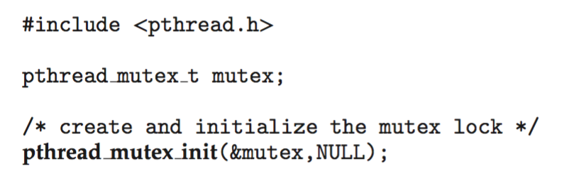
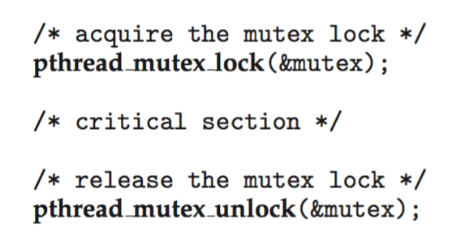
POSIX Mutex Locks
Creating and initializing the lock
Acquiring and releasing the lock

Slide 63
POSIX Mutex Locks API
#include <pthread.h> pthread_mutex_t mutex = PTHREAD_MUTEX_INITIALIZER;
int pthread_mutex_init(pthread_mutex_t *restrict mutex, const pthread_mutexattr_t *restrict attr);
int pthread_mutex_destroy(pthread_mutex_t *mutex); int pthread_mutex_lock(pthread_mutex_t *mutex);
int pthread_mutex_trylock(pthread_mutex_t *mutex);
int pthread_mutex_unlock(pthread_mutex_t *mutex);

Slide 64
Outline
Classic Problems of Synchronization
POSIX Synchronization
POSIX Mutex Locks
POSIX Semaphores
POSIX Condition Variables

Slide 65
POSIX Semaphores
POSIX provides two versions – named and unnamed.
Named semaphores can be used by unrelated processes by simply referring to the semaphore’s name
But, unnamed semaphores cannot

Slide 66
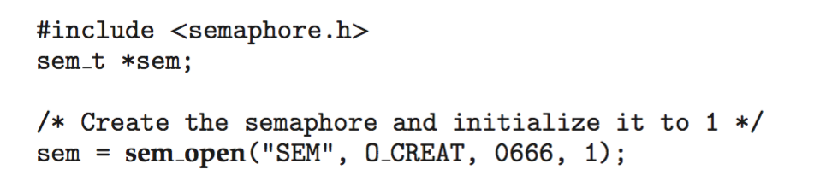
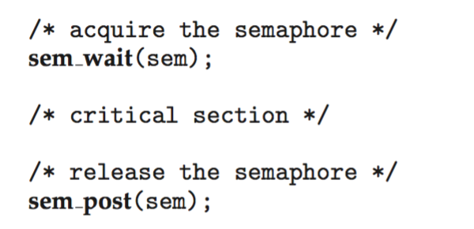
POSIX Named Semaphores
Creating create and open a named semaphore:
Another process can access the semaphore by referring to its name SEM.
Acquiring and releasing the semaphore:
name
flag
mode
Initial value

Slide 67
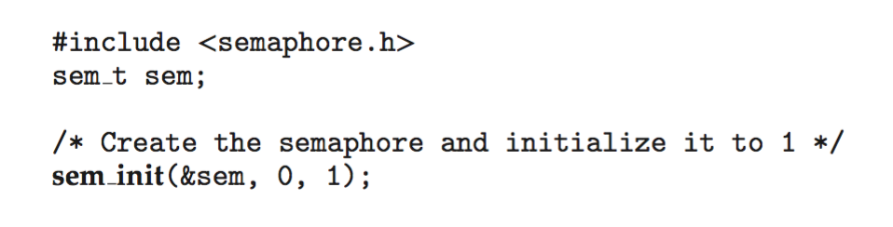
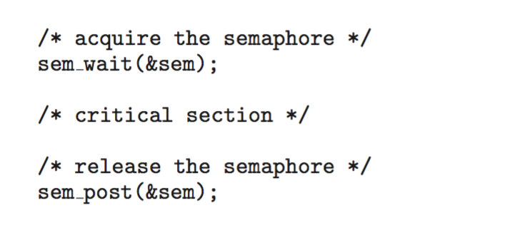
POSIX Unnamed Semaphores
Creating and initializing a unnamed semaphore:
Acquiring and releasing the semaphore:
a pointer to the semaphore
flag // level of sharing
Initial value

Slide 68
Outline
Classic Problems of Synchronization
POSIX Synchronization
POSIX Mutex Locks
POSIX Semaphores
POSIX Condition Variables

Slide 69
POSIX Condition Variables
Previously, condition variables are used within the context of a monitor
The monitor provides a locking mechanism to ensure data integrity
POSIX is typically used in C/C++
These languages do not provide a monitor
Thus, POSIX condition variables are associated with a POSIX mutex lock
The mutex lock is used to provide mutual exclusion

Slide 70
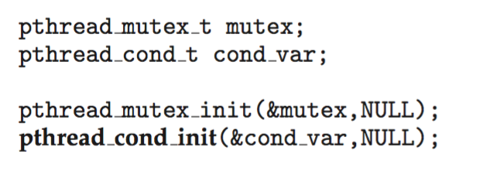
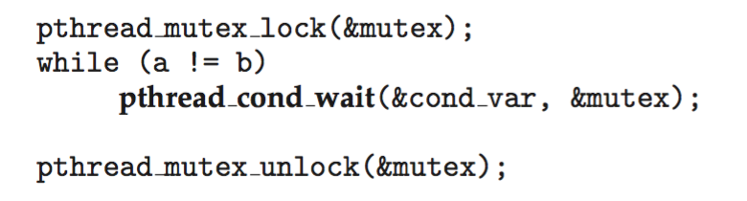
POSIX Condition Variables (Cont.)
Creating and initializing the condition variable:
Thread waiting for the condition a == b to become true:
The mutex lock is used to protect the data in the conditional clause (i.e., a and b) from a possible race condition
Pthread_condition_wait()would release the mutex lock

Slide 71
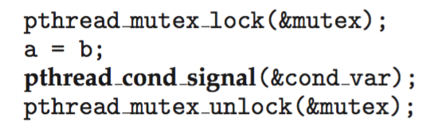
POSIX Condition Variables (Cont.)
A thread signaling another thread waiting on the condition variable via pthread_cond_signal()
Once the mutex is released, the signaled thread owns the mutex and returns control from pthread_cond_wait()
For safety, the signaled thread must put the conditional clause within a loop to re-check the condition, i.e., while (a!=b), after being signaled (see the previous slide)

